Slide 1


ZIPPER-A File Compression Model
Department of Computer Science and Engineering
Faculty of Engineering and Technology
Manav Rachna International Institute of Research and Studies
RIYA CHAUHAN-1/19/FET/BCS/006 RACHNA BEHL
YASH SHARMA-1/19/FET/BCS/061 ASSOCIATE PROFESSOR

Slide 2
ABOUT ZIPPER
Zipper is a file compression model which uses Huffman coding algorithm to encode and decode data or text in the file, and compresses the size of the file without any loss of the original content. Once decoded, the data will go back to its original format.
The idea behind Zipper is to build a model that enables us to transmit files or data in less transmission time while maintaining the confidentiality of the data being shared.

Slide 3



TECH REQUIREMENTS
VSCODE
CPP
GITHUB

Slide 4
INTRODUCTION TO DATA COMPRESSION
Encoding information using fewer bits than the original representation.
Lossless where no information is lost.
Compression reduces the data storage space.
Reduces transmission time needed over the network.
Data must be decompressed or decoded to be reused.

Slide 5
WHY DATA COMPRESSION?
Make optimal use of limited storage space.
Save time and help to optimize resources.
If compression and decompression are done in I/O processor, less time is required to move data to or from storage subsystem, freeing I/O bus for other work.
In sending data over communication line: less time to transmit and less storage to host.

Slide 6
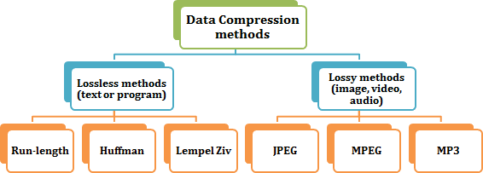
DATA COMPRESSION METHODS

Slide 7
HUFFMAN CODING
Huffman coding is a lossless data compression algorithm.
Huffman Coding is a technique of compressing data to reduce its size without losing any of the details. It was first developed by David Huffman.
The most frequent character gets the smallest code and the least frequent character gets the largest code.
The variable-length codes assigned to input characters are Prefix Codes, means the codes are assigned in such a way that the code assigned to one character is not the prefix of code assigned to any other character.

Slide 8
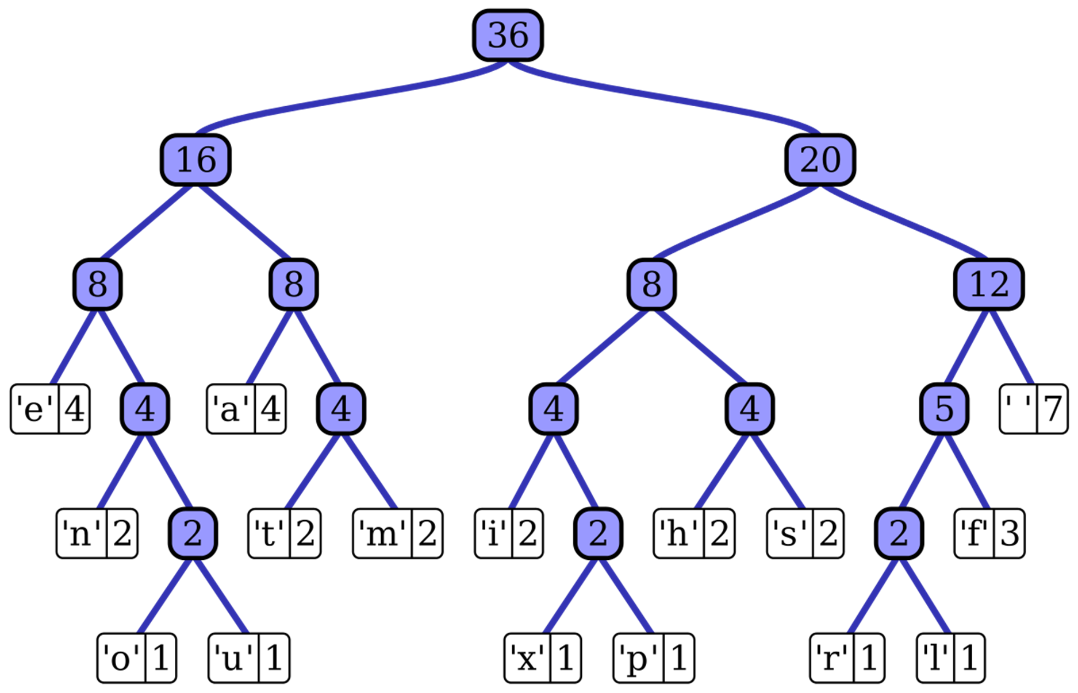
HUFFMAN CODING COMPRESSION ALGORITHM
Step1: Get frequencies
Step2: Build tree and Assign codes
Step3: Encode
Step4: Decode

Slide 9
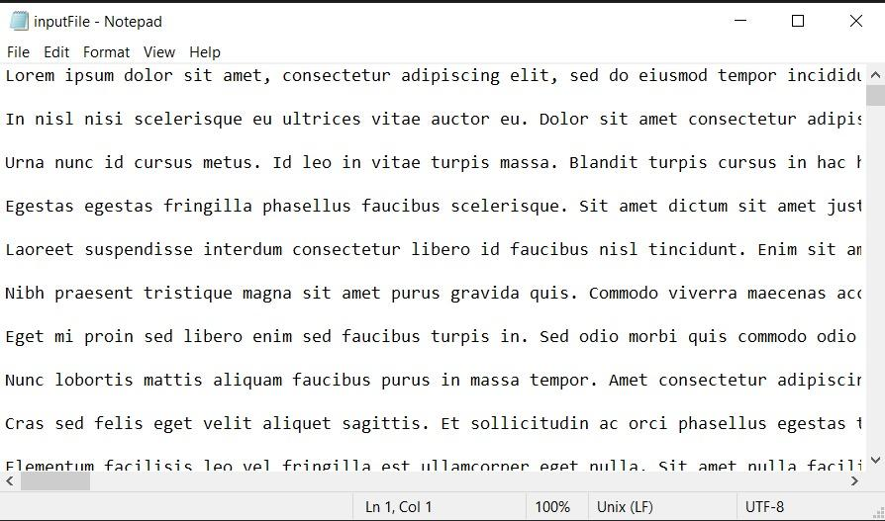
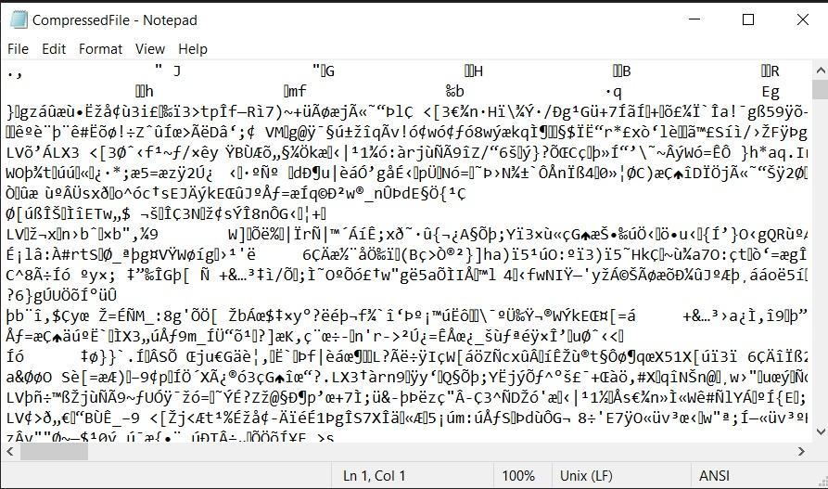
Original file & Compressed file
Original File
Encoded File

Slide 10

THANK YOU

